Slide 1
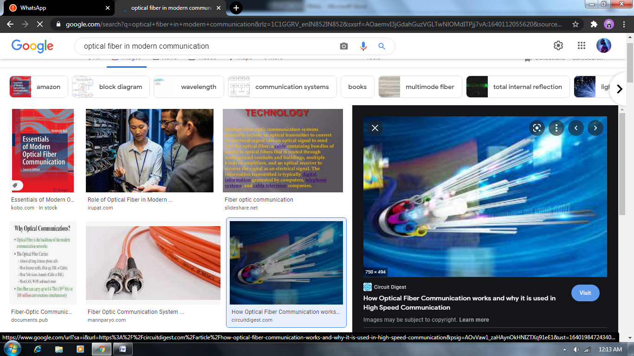
JAYPEE INSTITUTE OF INFORMATION TECHNOLOGY PHYSICS PROJECT OPTICAL FIBER AND COMMUNICATION
MADE BY :-
ARYAN RAZDAIN (B10 - BJ61567)
HIMANSHU DIXIT (B10 - B64178)
MOHIT GARG (B10 - B63996)

Slide 2
Work done by each member….
1) Aryan razdan :-
Help our team by choosing the topic and introduction,abstract ,and conclusion of the project and observation of the project.
2) Himanshu dixit :-
Help our team by choosing the topic and introduction,abstract ,and conclusion of the project and observation of the project.
3) Mohit garg :-
Help our team by observing the project and topic and give important terms,ideas,and help in finding and adding images in the project.

Slide 3
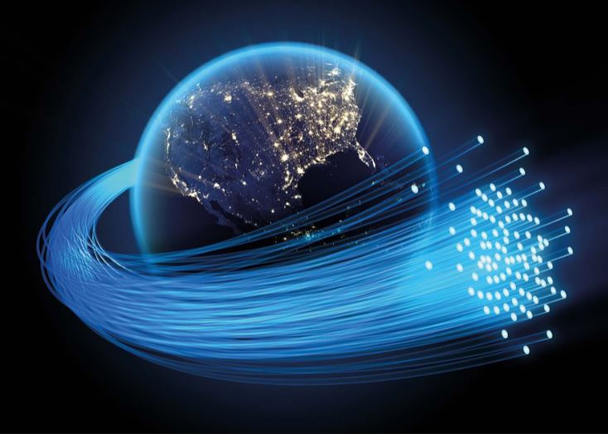
Index
Optical fiber
Types of optical fiber
Principle of optical fiber
Application of optical fiber
Optical fiber communication
Advantages and Disadvantages

Slide 4
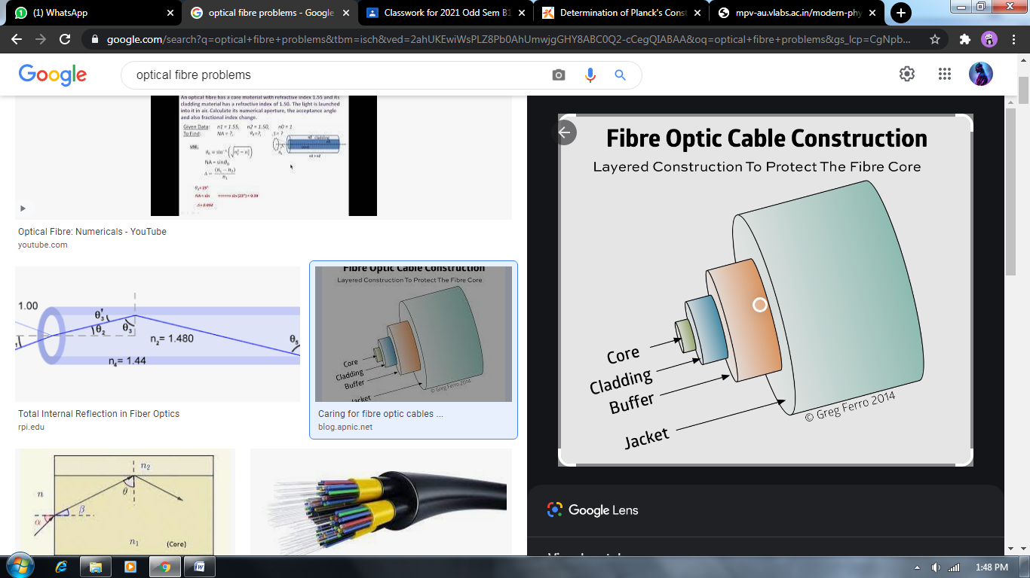
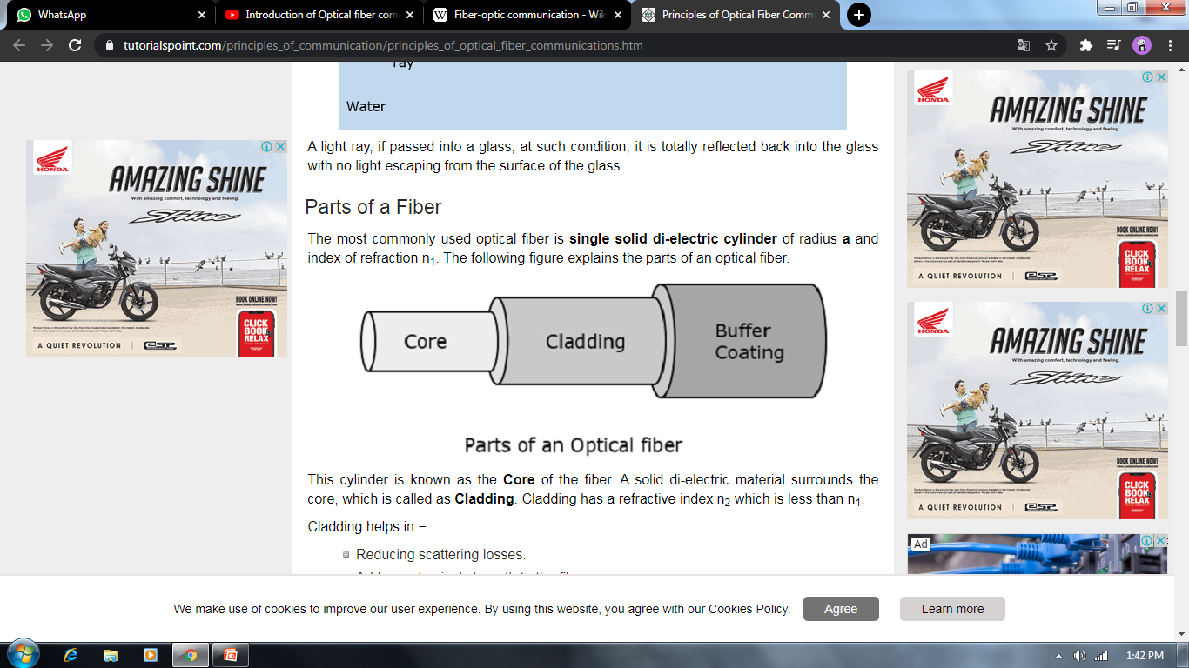
What is optical fiber?
1) A long thin thread of glass
through which information,
sound, data, etc. can be sent
in the form of light.
2) Optical fiber cable is an assembly
similar to an electrical cable,
but containing one or more optical
fibers that are used to carry light.

Slide 5
Types of optical fiber
Step index fiber
The refractive index of the core is uniform throughout and undergoes an abrupt change (or step) at the cladding boundary.
Graded-index fiber
The core refractive index is made to vary as a function of the radial distance from the center of the fiber
Both of these are further divided into :−
Single-mode fiber − These are excited with laser.
Multi-mode fiber − These are excited with LED.

Slide 6
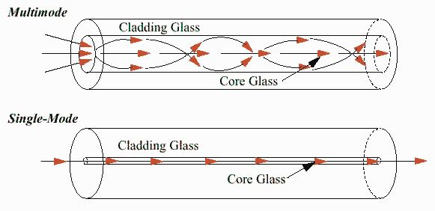
Types of optical fiber
1) Single mode fiber :-
Fiber supporting only one mode is
called single-mode or mono-mode fiber.
2) Multi mode fiber :-
Fiber supporting only one mode is
called single-mode or mono-mode fiber.
In a multi-mode fiber, rays of light
are guided along the fiber core by
total internal reflection.

Slide 7
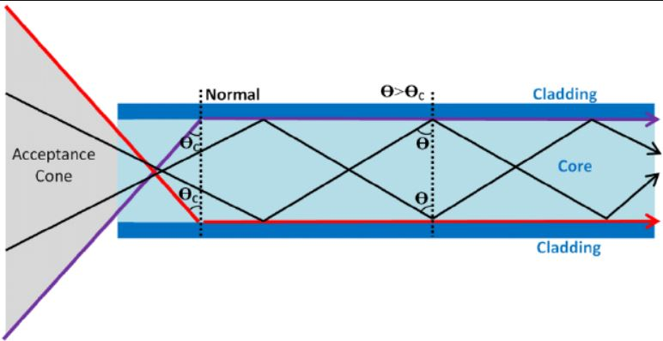
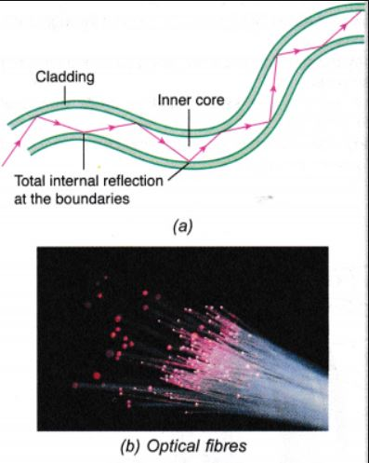
Principle of optical fiber
Optical fiber work on the principle of "total internal reflection" to capture the light transmitted in an optical fiber and confine the light to the core of the fiber. ... Beyond a certain angle, the refraction will cause light to be reflected from the surface.

Slide 8
Application of optical fiber
1) Optical fiber communication :-
Optical fiber can be used as a medium for telecommunication and networking
because it is flexible and can be bundled as cables. It is especially advantageous for
long-distance communications,because light propagates through the fiber with little
attenuation compared to electrical cables.
2) Fiber optic sensors:
Fibers have many uses in remote sensing. In some applications, the sensor is itself an
optical fiber. In other cases, fiber is used to a non-fiber optic sensor to a
measurement system.
3) Fibers are widely used in illumination applications. They are used as light guides in
medical and other applications where bright light needs to be shone on a target without
a clear line-of-sight path and etc.

Slide 9
Optical fiber communication
Fiber optic communication is a method of transmitting information from one place to another by sending pulse of light through an optical fiber.
The light forms an electromagnetic carrier wave that is modulated to carry information.
Optical fiber is preferred over electrical cabling because it offer high bandwidth,long distance communication,more information capacity,high degree of signal security,lack of cross talk,enhance safety and immunity to electromagnetic interfence.

Slide 10
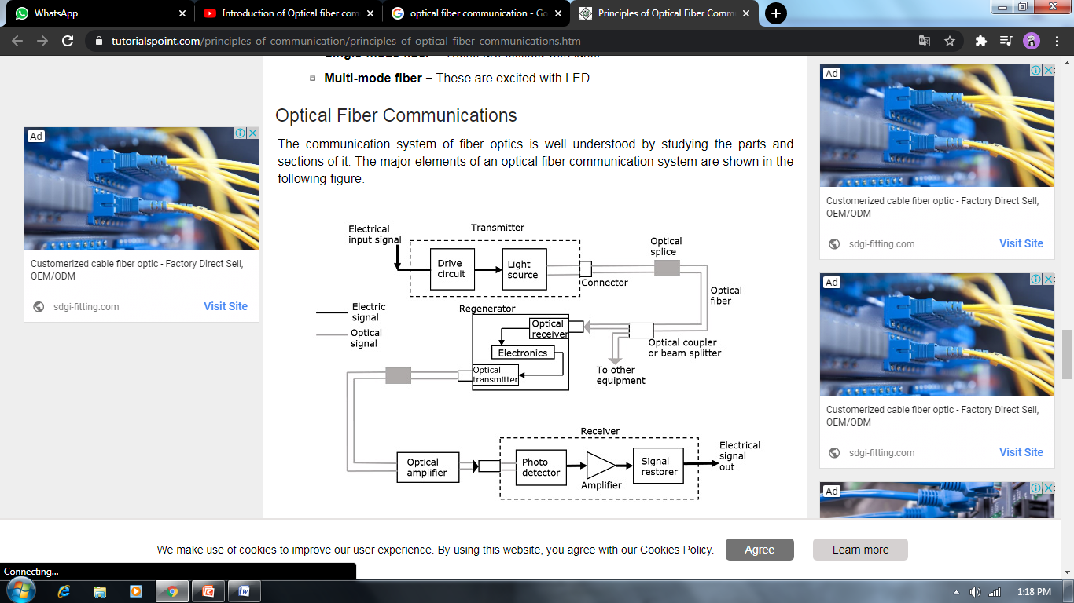
The basic components are light signal transmitter, the optical fiber, and the photo detecting receiver. The additional elements such as fiber and cable splicers and connectors, regenerators, beam splitters, and optical amplifiers are employed to improve the performance of the communication system.

Slide 11
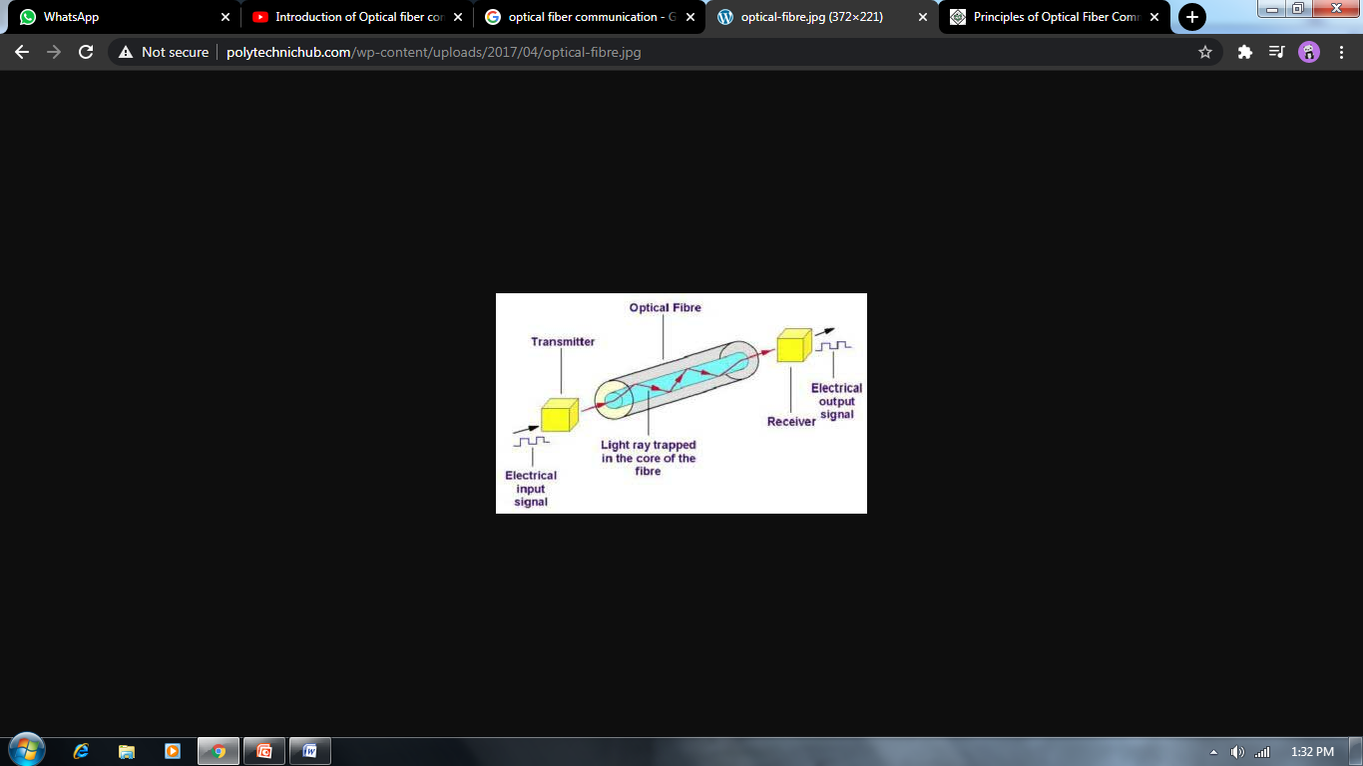
Functional Advantages
The transmission bandwidth of the fiber optic cables is higher than
the metal cables.
The amount of data transmission is higher in fiber optic cables.
The power loss is very low and hence helpful in long-distance
transmissions.
Fiber optic cables provide high security and cannot be tapped.
Fiber optic cables are the most secure way for data transmission.
Fiber optic cables are immune to electromagnetic interference.
These are not affected by electrical noise.

Slide 12
Physical Advantages
The capacity of these cables is much higher than copper wire cables.
Though the capacity is higher, the size of the cable doesn’t increase like it does in copper wire cabling system.
The space occupied by these cables is much less.
The weight of these FOC cables is much lighter than the copper ones.
Since these cables are di-electric, no spark hazards are present.
These cables are more corrosion resistant than copper cables, as they are bent easily and are flexible.
The raw material for the manufacture of fiber optic cables is glass, which is cheaper than copper.
Fiber optic cables last longer than copper cables

Slide 13
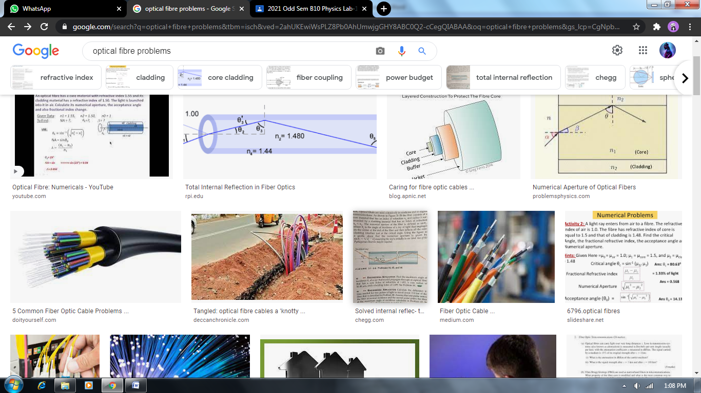
Disadvantages
Though fiber optic cables last longer, the installation cost is high.
The number of repeaters are to be increased with distance.
They are fragile if not enclosed in a plastic sheath. Hence, more protection is needed than copper ones

Slide 16
Thanking you In anticipation By… Himanshu dixit ARYAN RAZDAN MOHIT GARG

